Slide 1
Midterm Proposal
Zhipeng SUn

Slide 2
Ideas
Continue working on midterm project.
Include more vehicle data, at least 3 vehicles per brand, so that the logo icon is clickable.
Modal content improvement.
Using JavaScript as a content storage(?)
Put on more small widgets, like carousel slides.
Add some cool animation as effects.

Slide 3
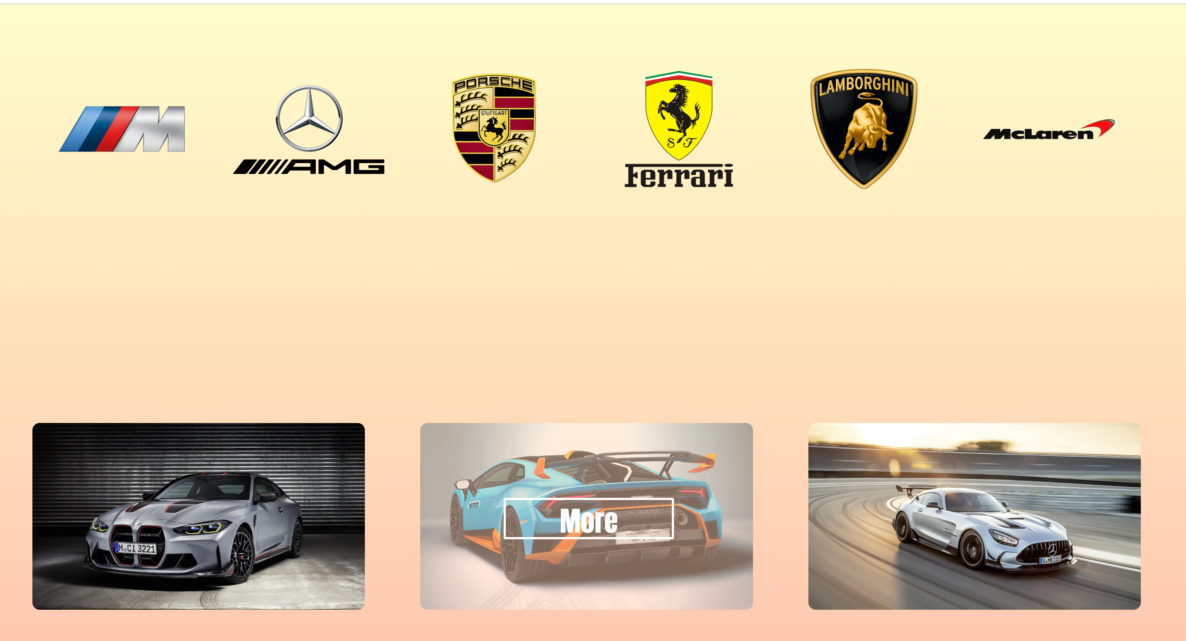

Slide 4
Skills Requried
Review Javascript, figure out how to directly input text string from javascript into the html
Figure out how to put videos in the modal box
More detailed research on the content.
Learn more animations.

